Slide 1

CIFAR - 10 Image Classification
Ashish Sharma
12/08/22

Slide 2
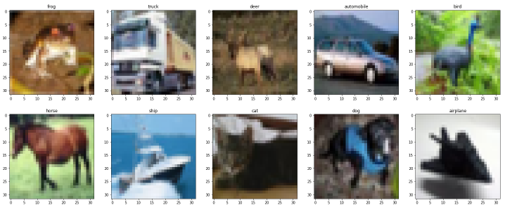
Problem Statement
To classify the various categories(or classes) present in the given dataset.
[ Airplane, Automobile, Bird, Cat, Deer, Dog, Frog, Horse, Ship, Truck ]

Slide 3
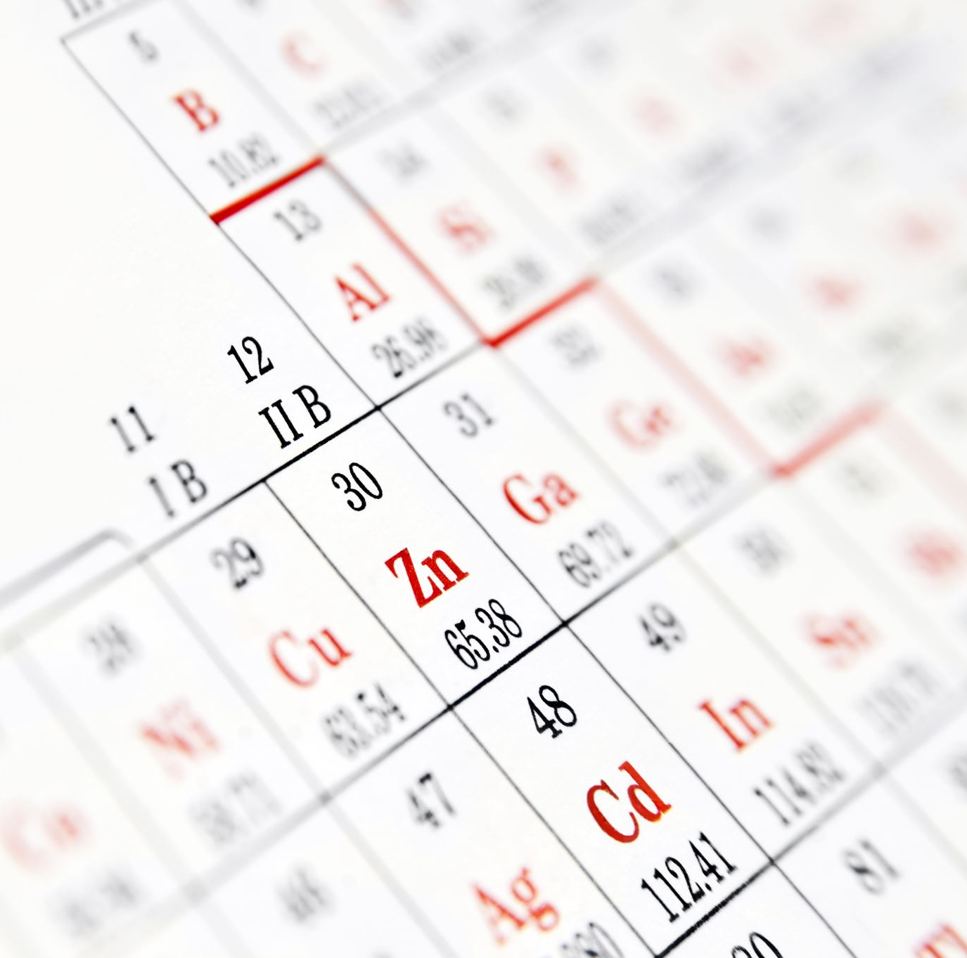
Dataset Description
This dataset is popularly called the “CIFAR-10” data set.
The CIFAR-10 dataset is a repository of 60000 entries extracted from the 80 million tiny images dataset.
The dataset provides 60000 RGB values of size 32x32 in numerical data types. Every class consists of 6000 images and the following dataset is split into 50000 training images and 10000 testing images.

Slide 4
Approach
Performing exploratory data analysis on the dataset to apply various deep learning models to classify the various categories and improvising the results using various hyperparameter tuning.
Estimating the performance of the model using various techniques. Also focusing on decreasing the error rate in order to get best results with high F1, recall and precision scores.
As per different research done by the researchers Convolutional Neural Networks would be the best model to implement.

Slide 5
Methodology
Cleaning and balancing the dataset:
Developing the models to classify various categories using EDA and parameter tuning
Results

Slide 6
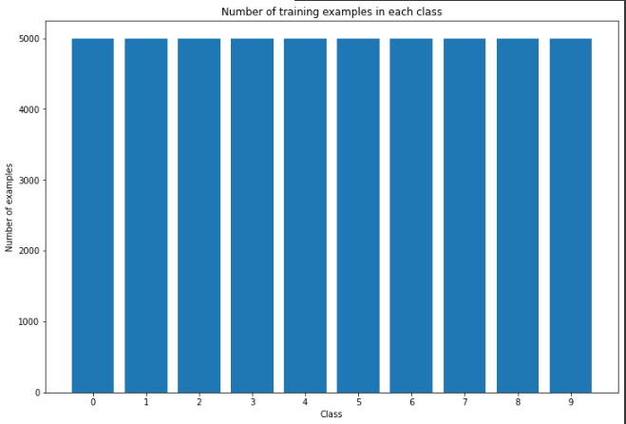
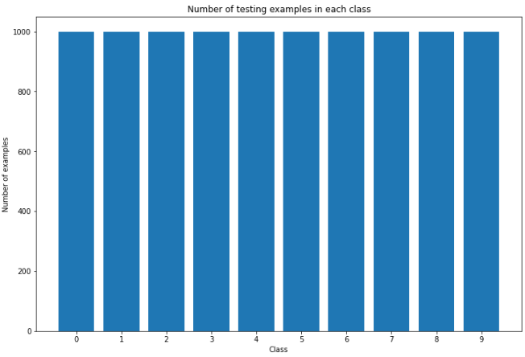
Data Imbalance and Distribution across features
Training Samples
Testing Samples

Slide 7

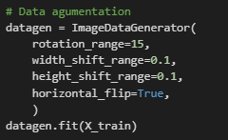
One Hot Encoding
classes are in the character data type and we need it to convert into integer data type for applying it into the models. With the help of this encoding, the number may be converted into a binary vector with 10 elements and an index for the class value of 1. The to_categorical() utility function allows us to accomplish this.
Data Augmentation
Perform data augmentation which makes copies of examples in the dataset with small modifications. This has a regularizing effect which can help in performance and we have various augmentations to perform such as rotating the image, shifting the width or height of the image, or flipping the image.

Slide 8
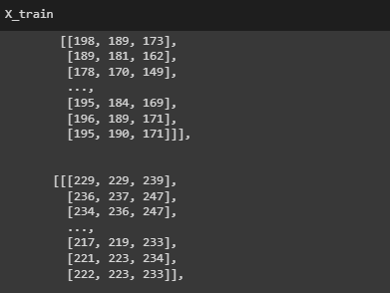
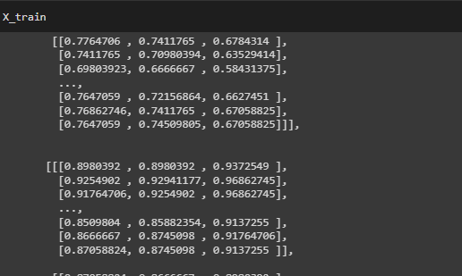
Normalizing
Each image has been assigned to a value from range 0 to 255, as we are not aware of the best way to scale the values, but we know scaling is needed, so to achieve that the data or values are normalized in the range from 0 to 1. This approach is done by first converting the integer value to float value and then dividing it by 255.

Slide 9
Data Modeling
Basic Neural Network
Simple Model with Convolution Layer
Complex Model with increased Dropout, Batch Normalization
Complex Model with Batch Normalization, SGD, L2 Norm

Slide 10
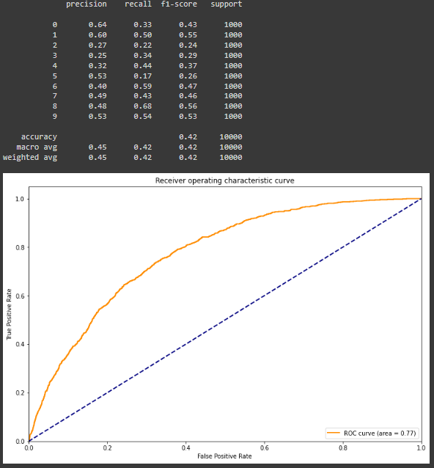
1. Basic Neural Network
Classification Report
implement a network without the convolution layer, as expected there were no great results and the accuracy score turned out to be 42.41%.
ROC - AUC we can interpret that the model is not classifying the categories very well. The model is clearly not complex enough to extract the features from the images.
Some of the classes are struggling with the model as they are complex in nature
Accuracy Score – 42%
Test Loss - 1.61

Slide 11
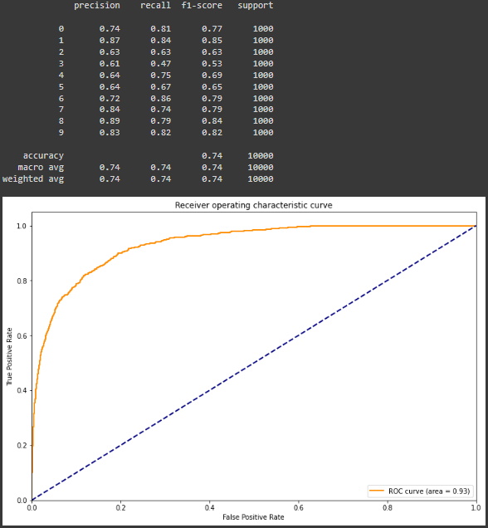
2. Simple Model with Convolution Layers
Classification Report
Basic model with convolutional layers, also the learning rate was changed to 0.0001 and with the RMS optimizer. There are 4 convolution layers using the 3x3 max pooling.
With the help of the following parameters 73.82% accuracy was achieved with significant reduction in test loss
ROC- AUC curve is good that means the classes are being classified very well.
Accuracy Score – 74%
Test Loss - 0.75

Slide 12
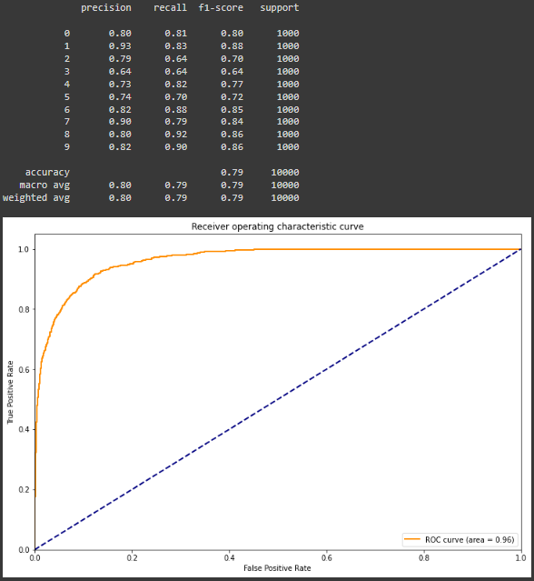
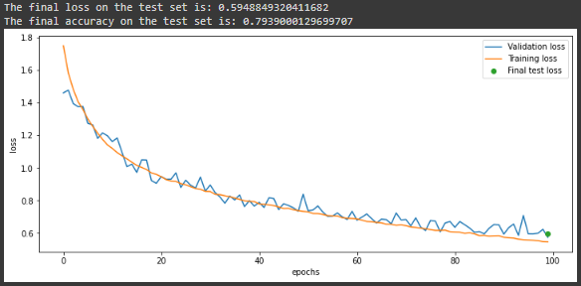
3. Complex Model with Increasing dropout, Batch Normalization
Classification Report
There is a significant increase from 74 to 79.5% also there is reduction in loss from 0.75 to 0.59
All classes are performing pretty well except a couple of classes due to their complexity

Slide 13
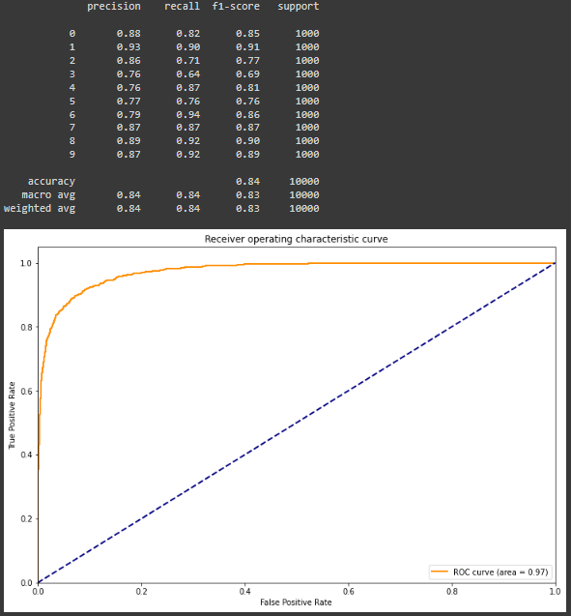
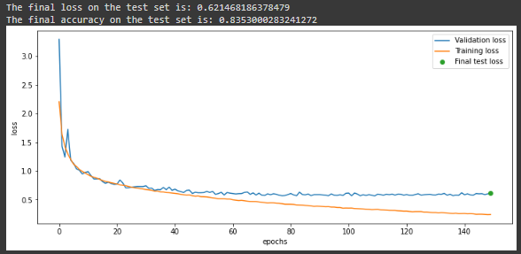
4. Complex Model with batch normalization, Stochastic Gradient Descent, L2 norm Regularizers
Classification Report
CNN network with batch normalization, SGD, weight decay and regularizers to improve the model further, to achieve 84% accuracy with low losses to 0.57
‘elu’ function is used which is an improvement of ‘ReLu’ function. L2 norm regularizers were used to prevent overfitting in the model and adjusting the loss function.

Slide 14
Results
Results and performance of the different models trained and tested.
Model | Accuracy | Test Loss
Basic Neural Network | 42.41% | 1.61
Simple CNN | 73% | 0.75
Complex Model with increased dropout, batch normalization | 79.5% | 0.59
Complex Model with batch normalization, Stochastic Gradient Descent, L2 norm | 84% | 0.57

Slide 15
Conclusions
The data which we had was perfectly balanced when tested for the same, hence there was less signs of overfitting and underfitting.
CNN is the best performing model for image recognition and classifications.
Worked on 4 different improving models with varying the parameters increasing the accuracy and performance metrics.
Overall the model with data augmentation, hyperparameter tuning and batch normalization was the best model to work with giving the highest accuracy.
Each algorithm used has been tested with proper confusion matrix and classification report has been provided establishing the accuracy. The F1 scores are in relation to the precision and accuracy for each algorithm

Slide 16
THANK YOU!

